Slide 1




MANUEL S. ENVERGA UNIVERSITY FOUNDATION
COLLEGE OF COMPUTING AND MULTIMEDIA STUDIES
CHED CENTER OF DEVELOPMENT IN IT EDUCATION
MERGE
SORT
DATA STRUCTURES AND ALGORITHMS

Slide 2





GROUP 5
MEMBERS
ROOSC ZANO
NEO MEDRANO
ROMINA VICTORIA SALAPARE
ROENTGEN COMPRA
SEAN MIKAEL CID

Slide 3

Learning Outcomes
Understanding Merge Sort: Learn how it splits, sorts, and merges subarrays using the divide-and-conquer approach.
Recognizing Limitations: Understand its space overhead and why it’s less ideal for in-place sorting.
Comparison with Algorithms: Compare its efficiency and stability with Quick Sort and Bubble Sort.
Implementation and Application: Write functions for sorting arrays and use it in projects requiring stable sorting.
Parallel Processing: Recognize its suitability for parallel processing due to independent subarray sorting.
Implement search functionality in a real-world project

Slide 4
What is Merge Sort?
Merge sort is a popular sorting algorithm known for its efficiency and stability. It follows the divide-and-conquer approach to sort a given array of elements. It works by recursively dividing the input array into smaller subarrays and sorting those subarrays then merging them back together to obtain the sorted array.
In simple terms, we can say that the process of merge sort is to divide the array into two halves, sort each half, then merge the sorted halves back together. This process is repeated until the entire array is sorted.

Slide 5
Applications of Merge Sort
Sorting Large Datasets:
Merge Sort is widely used for external sorting, where datasets are too large to fit entirely in memory. For example, in systems that process large files or databases stored on disk, Merge Sort can split the data into smaller chunks, sort them individually, and then merge the sorted chunks efficiently.
Example: You have a list of numbers: [8, 1, 3, 7, 2, 6]. Merge Sort splits it into smaller parts, sorts each part, and then combines them back together into a sorted list: [1, 2, 3, 6, 7, 8].

Slide 6
Applications of Merge Sort
Sorting Linked Lists:
Merge Sort is particularly suitable for sorting linked lists because it does not require random access to elements like Quick Sort. Its ability to split the list in O(n)O(n)O(n) time and merge sorted sublists efficiently makes it an ideal choice for such data structures.
Example: A linked list 4 -> 2 -> 6 -> 1 is split into 4 -> 2 and 6 -> 1, sorted separately, and then merged to give 1 -> 2 -> 4 -> 6.

Slide 7
Applications of Merge Sort
Stable Sorting Needs:
As a stable sorting algorithm, Merge Sort preserves the relative order of elements with equal keys. This makes it valuable in applications like database management systems, where maintaining the stability of records with similar fields is critical for consistency.
Example: Sorting a list of tuples [("A", 3), ("B", 1), ("C", 3)]. Merge Sort keeps the order of "A" and "C" the same as they have the same value (3): [("B", 1), ("A", 3), ("C", 3)].

Slide 8
Applications of Merge Sort
Parallel Processing:
The divide-and-conquer nature of Merge Sort lends itself well to parallel processing. Subarrays can be sorted independently on different processors, significantly improving performance for large-scale data in distributed systems or multi-core environments.
Example: A list [9, 7, 3, 5] is split into [9, 7] and [3, 5]. Both halves are sorted in parallel, then merged to give [3, 5, 7, 9].

Slide 9
Applications of Merge Sort
Merge Algorithms and Multiway Merging:
Merge Sort is often used as a foundation for algorithms that require merging sorted data. For example, in multiway merging, sorted files or streams from different sources are combined into one sorted output, which is a common requirement in data integration systems and streaming platforms.
Example: Multiway merging is used to combine multiple sorted lists, like merging [1, 4], [2, 5], and [3, 6] into a single sorted list [1, 2, 3, 4, 5, 6].

Slide 10
Advantages of Merge Sort
It is quicker for larger lists because unlike insertion and bubble sort it doesn't go through the whole list seveal times.
It has a consistent running time, carries out different bits with similar times in a stage.

Slide 11
Disadvantages of Merge Sort
Slower comparative to the other sort algorithms for smaller tasks.
Goes through the whole process even if the list is sorted before.
Uses more memory space to store the sub elements of the initial split list.

Slide 12
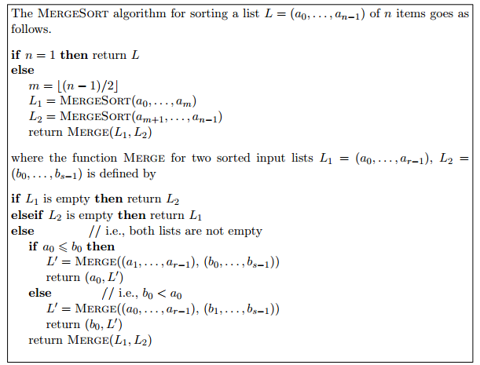
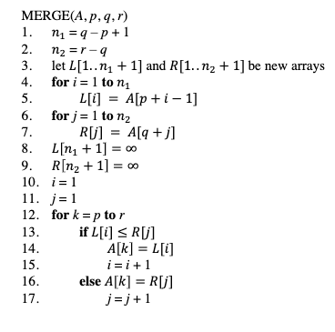
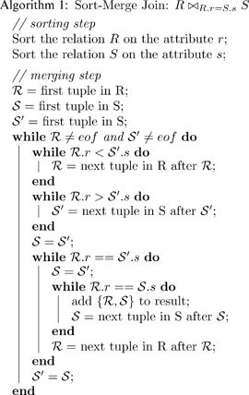
Pseudocode Algorithm

Slide 13
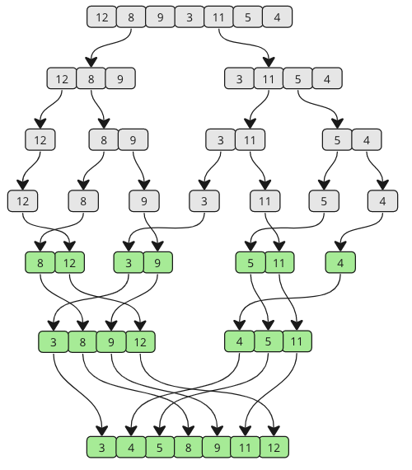
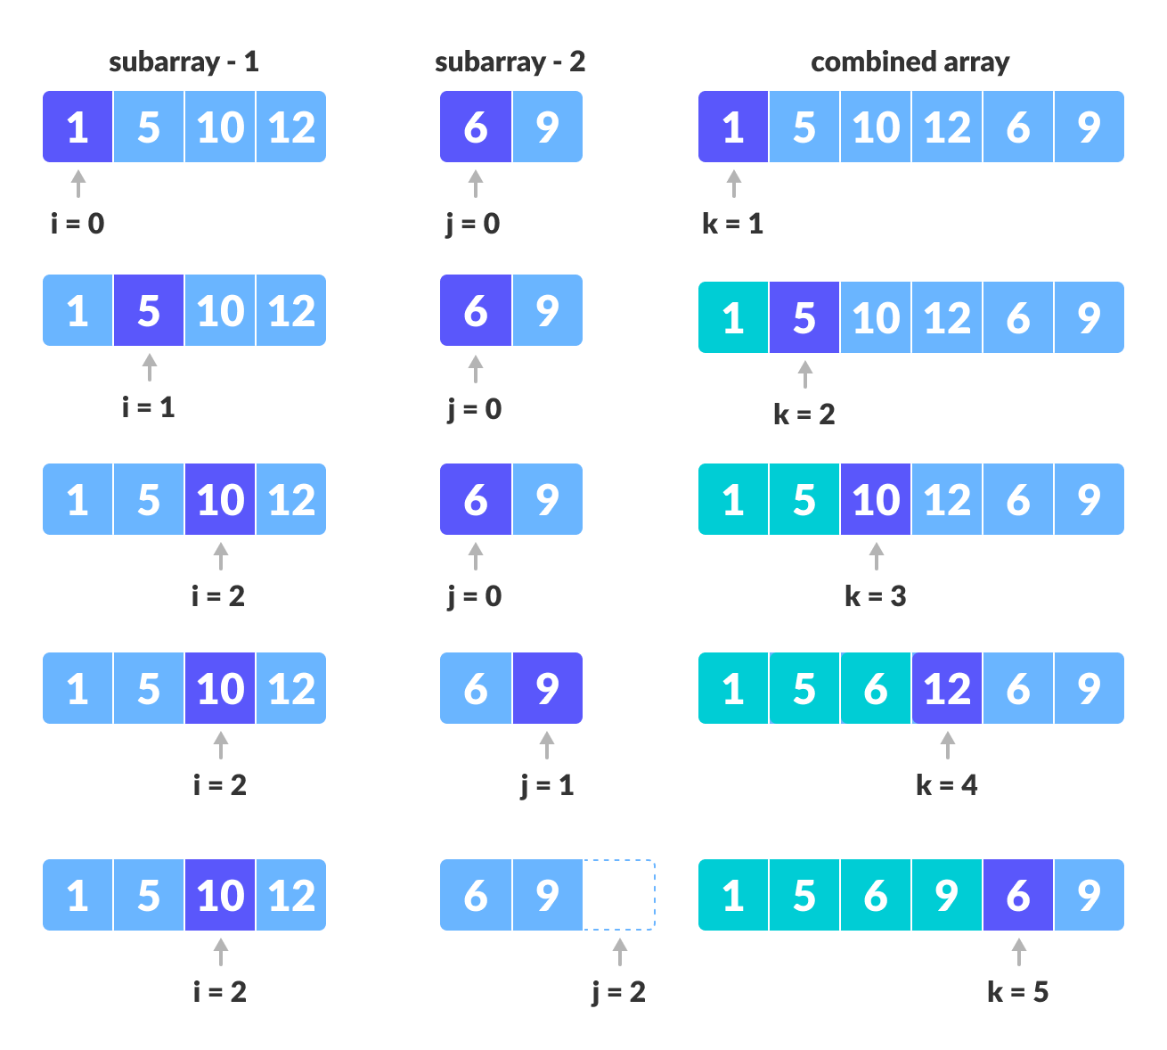
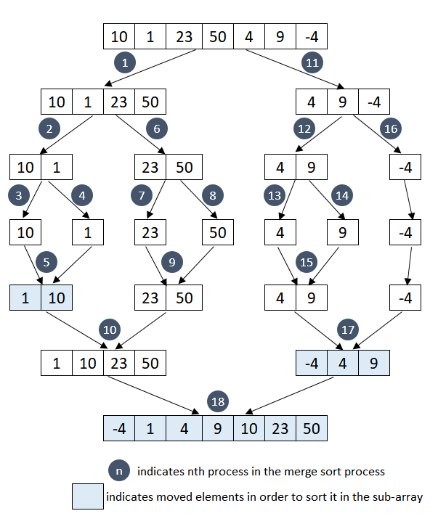
Examples of Merge Sort

Slide 14
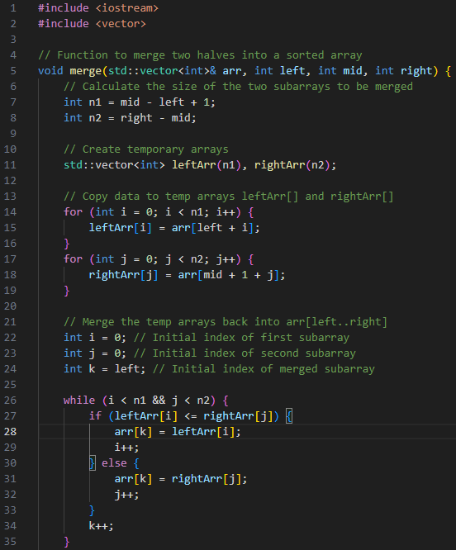
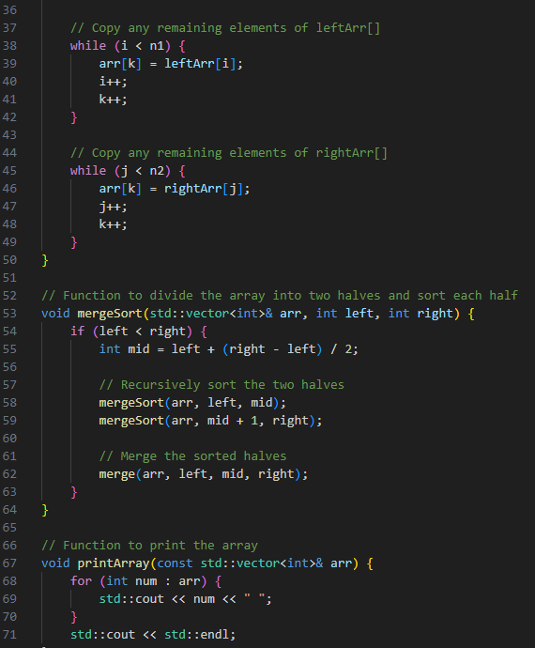
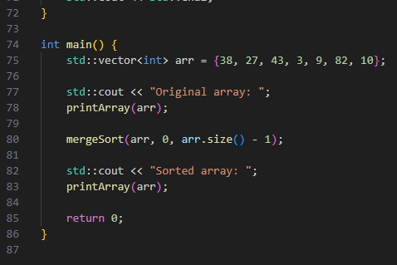
Source Code Implementation

Slide 15
MANUEL S. ENVERGA UNIVERSITY FOUNDATION
COLLEGE OF COMPUTING AND MULTIMEDIA STUDIES
CHED CENTER OF DEVELOPMENT IN IT EDUCATION
THANK
YOU!

